Slide 1
ZOMATO ANALYSIS
20 January 2023

Slide 2
INTRODUCTION
Objective
Analyze Zomato restaurant data to derive meaningful insights
Tools Used
Excel
Power BI
Tableau
Overview
Built data models for seamless data integration and analysis.
Explored restaurant metrics, including total count, popular cuisines, and monthly performance trends.
Incorporated interactive features like slicers for dynamic filtering and enhanced user engagement.

Slide 3
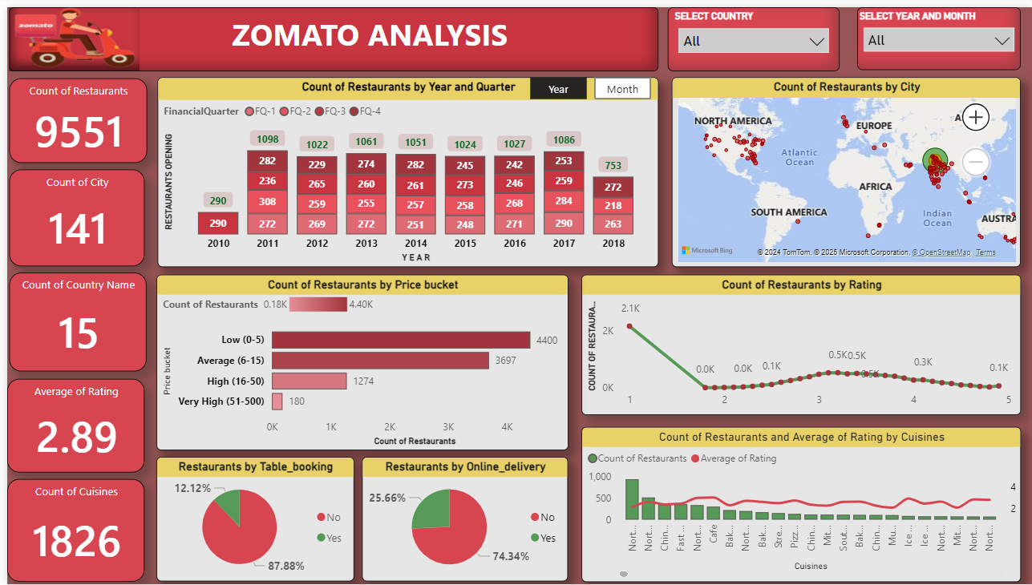


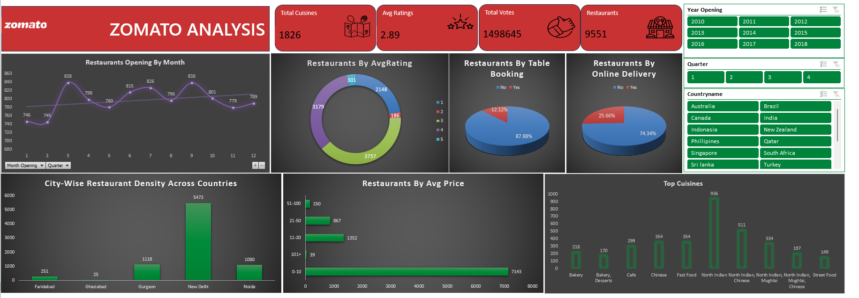
Overview of KPIs
The project focuses on analyzing restaurant data across various metrics:
Count of Restaurants: A total of 9,551 restaurants are included in the dataset.
Count of Cities: The dataset covers restaurants in 141 cities worldwide.
Count of Countries: A total of 15 countries are represented.
Average Ratings: The average rating across all restaurants is 2.89.
Count of Cuisines: A wide variety of 1,826 unique cuisines are offered.
Total Votes: User engagement includes 1,498,645 total votes.

Slide 4

Excel Dashboard

Slide 5

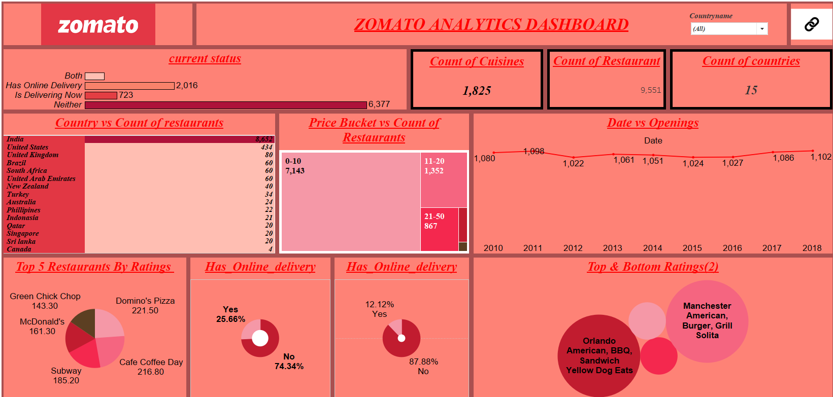
Tableau Dashboard

Slide 6

PowerBI Dashboard

Slide 7

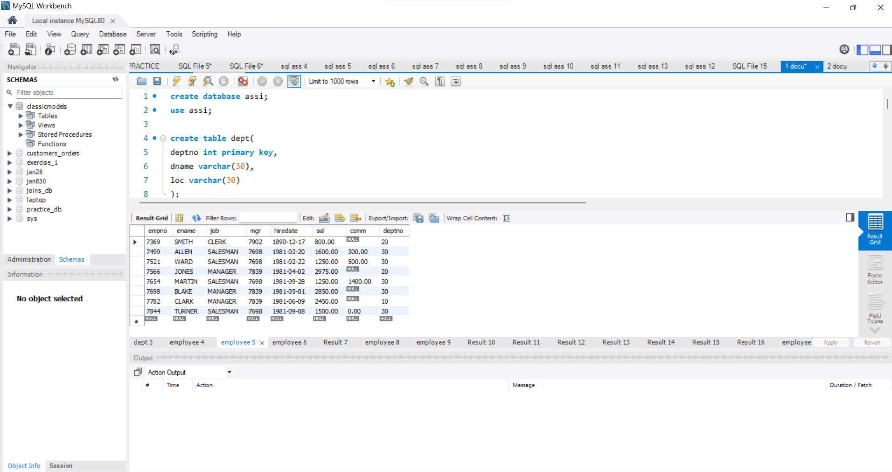
SQL Queries

Slide 8
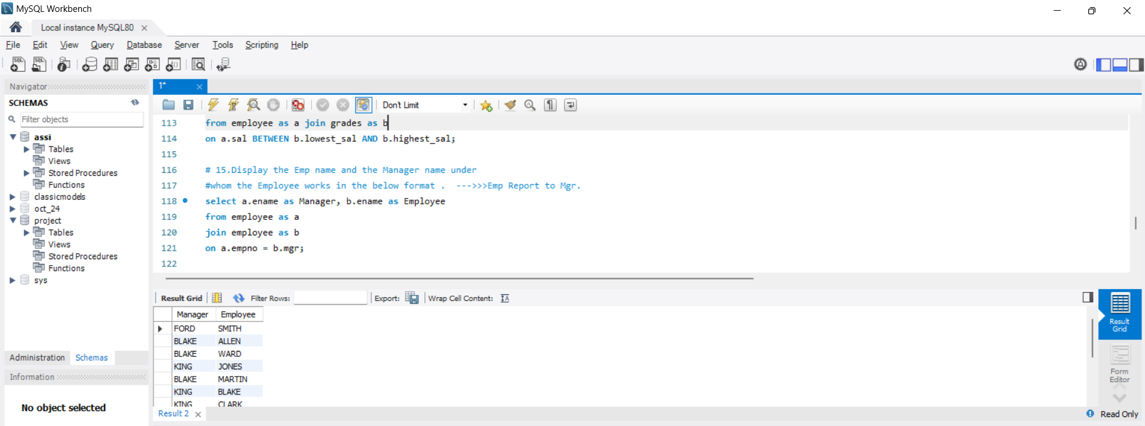
SQL Queries

Slide 9
Project Summary
This project aimed to analyze and visualize data from the Zomato restaurant database using various tools to gain meaningful insights.
Gained hands-on experience with Tableau, Power BI, and Excel dashboards for creating interactive visualizations.
We gained insights such as only 25.66% of restaurants offering online delivery, highlighting a significant opportunity for digital transformation, and a steady growth in restaurant openings from 2010 to 2018, indicating an expanding market
The findings from this project offer valuable information to support better decision-making in the restaurant industry.

Slide 10
Thank You

